Slide 1
Performance Evaluation Dashboard
Assignment-3
Group Members:
-Jatinder Bali, NUID: 001539121
-Sakshee Naik, NUID: 001580738
-Rakesh Lokam, NUID: 001560489

Slide 2
Problem Statement
Design and build a system that aims at evaluating the quality of education provided by a university to the students through the use of software engineering techniques. The application metricises feedbacks obtained from alumni and students over a span of 5 years and determines the quality of education delivered to the students.

Slide 3
Proposed Solution
Our proposed solution focuses on building a performance evaluation dashboard that takes into account all alumni and student feedbacks in order to use to them as metrics for the quality of education that a university is providing the students. With such insights, many new students will be able to have a better idea about the course work and university ranking.
The entire hierarchical structure of the application takes in relevant coursework, Jobs after graduation, faculty records, alumni records and based on these factors and their respective weightage, the system will grade the university based on the internally evaluated points.
In order to provide a holistic view at the university’s education quality, we provide different roles and modules for the admin, student and faculty.

Slide 4
Classes and Entities
The classes and their corresponding attributes have been listed as follows:
Department: Each university has multiple departments, this class will consist of the department ID, the courses offered by that particular department along with their schedules, faculty, students and average GPA of any course.
Transcript: Contains the Student details, ID, Course details and schedule, seating and enrolments of students along with semester wise GPA of each student.
Course: This class contains detailed information about each course including scheduling details, credit details, number of available seats and waitlist along with the details of faculty teaching the course
Student Directory: This is an embodying class for the Student object containing all the list of currently enrolled students at the university.

Slide 5
Student: Consists of details of the student such as Student ID, email address and contact information. It will also contain the department of the student.
Alumni Directory: Contains a list of all the graduated alumni’s of the university.
Alumni: One of the main implementation factors for the system as the entire evaluation pattern is based on the feedback provided by the alumni and students of the courses and faculty that helped them be successful in the career paths. Consists of Student details, year of passing, GPA details, employment details and career growth information over the last 5 years.
Faculty Directory: Contains a list of all the faculty currently teaching on campus.
Faculty: Consists of the Faculty details, the courses that they teach and course schedules depending upon the strength of class.
Ranking: Based on the evaluation of performance metrics based on feedback from alumni and students, the ranking given to the university’s education quality can be measured.
Employment: Will consist the details of the job of an alumni, including organization name, job role and salary details.

Slide 6
Roles
Admin: Access to performance evaluation metrics and dashboard, derives final insight from raw data.
Student: Can access and update feedback forms, viewing rights for all other classes.
Faculty: Viewing rights for all classes.

Slide 7
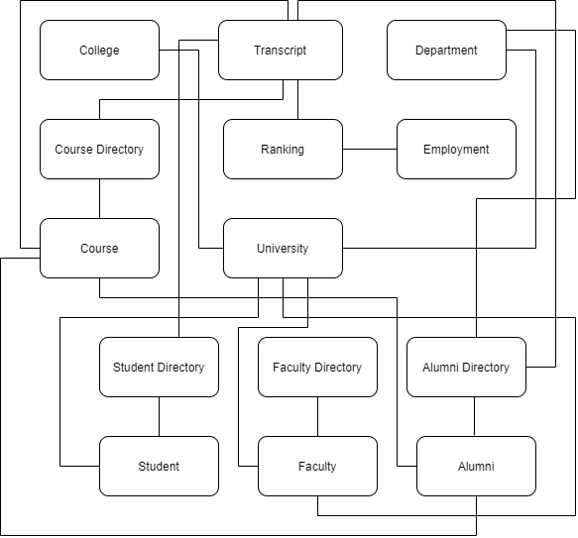
Object Model Diagram

Slide 8
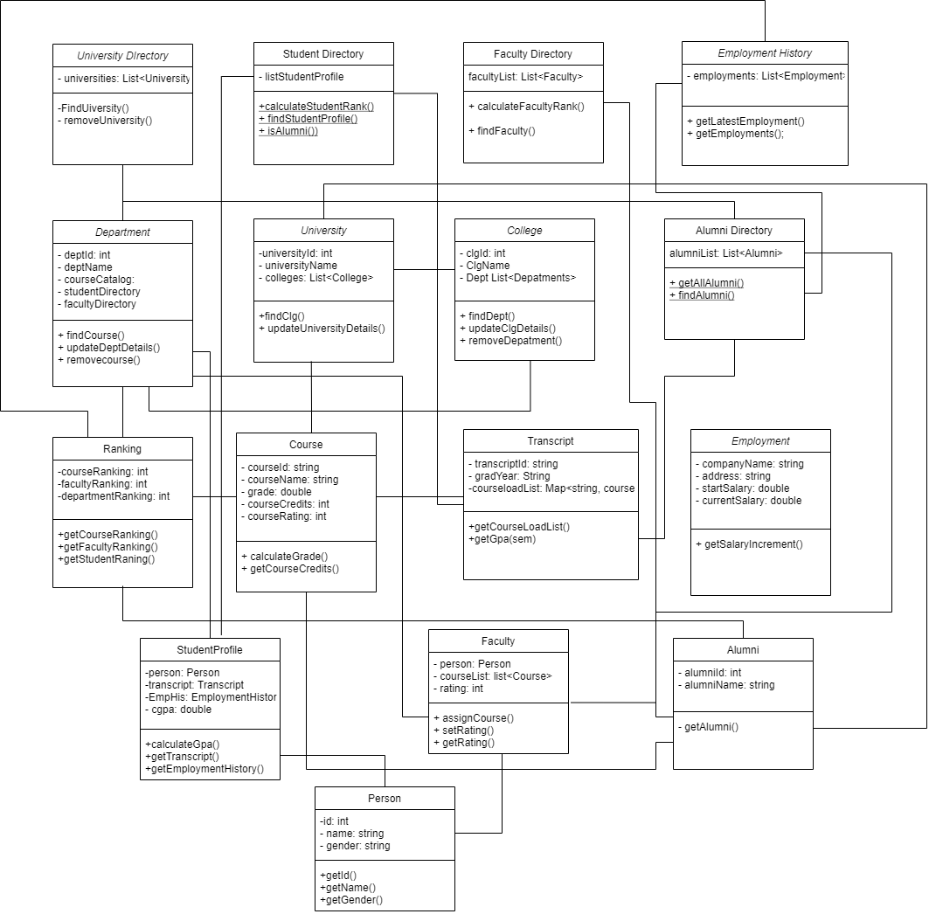
C l a s s D I a g r a m

Slide 9
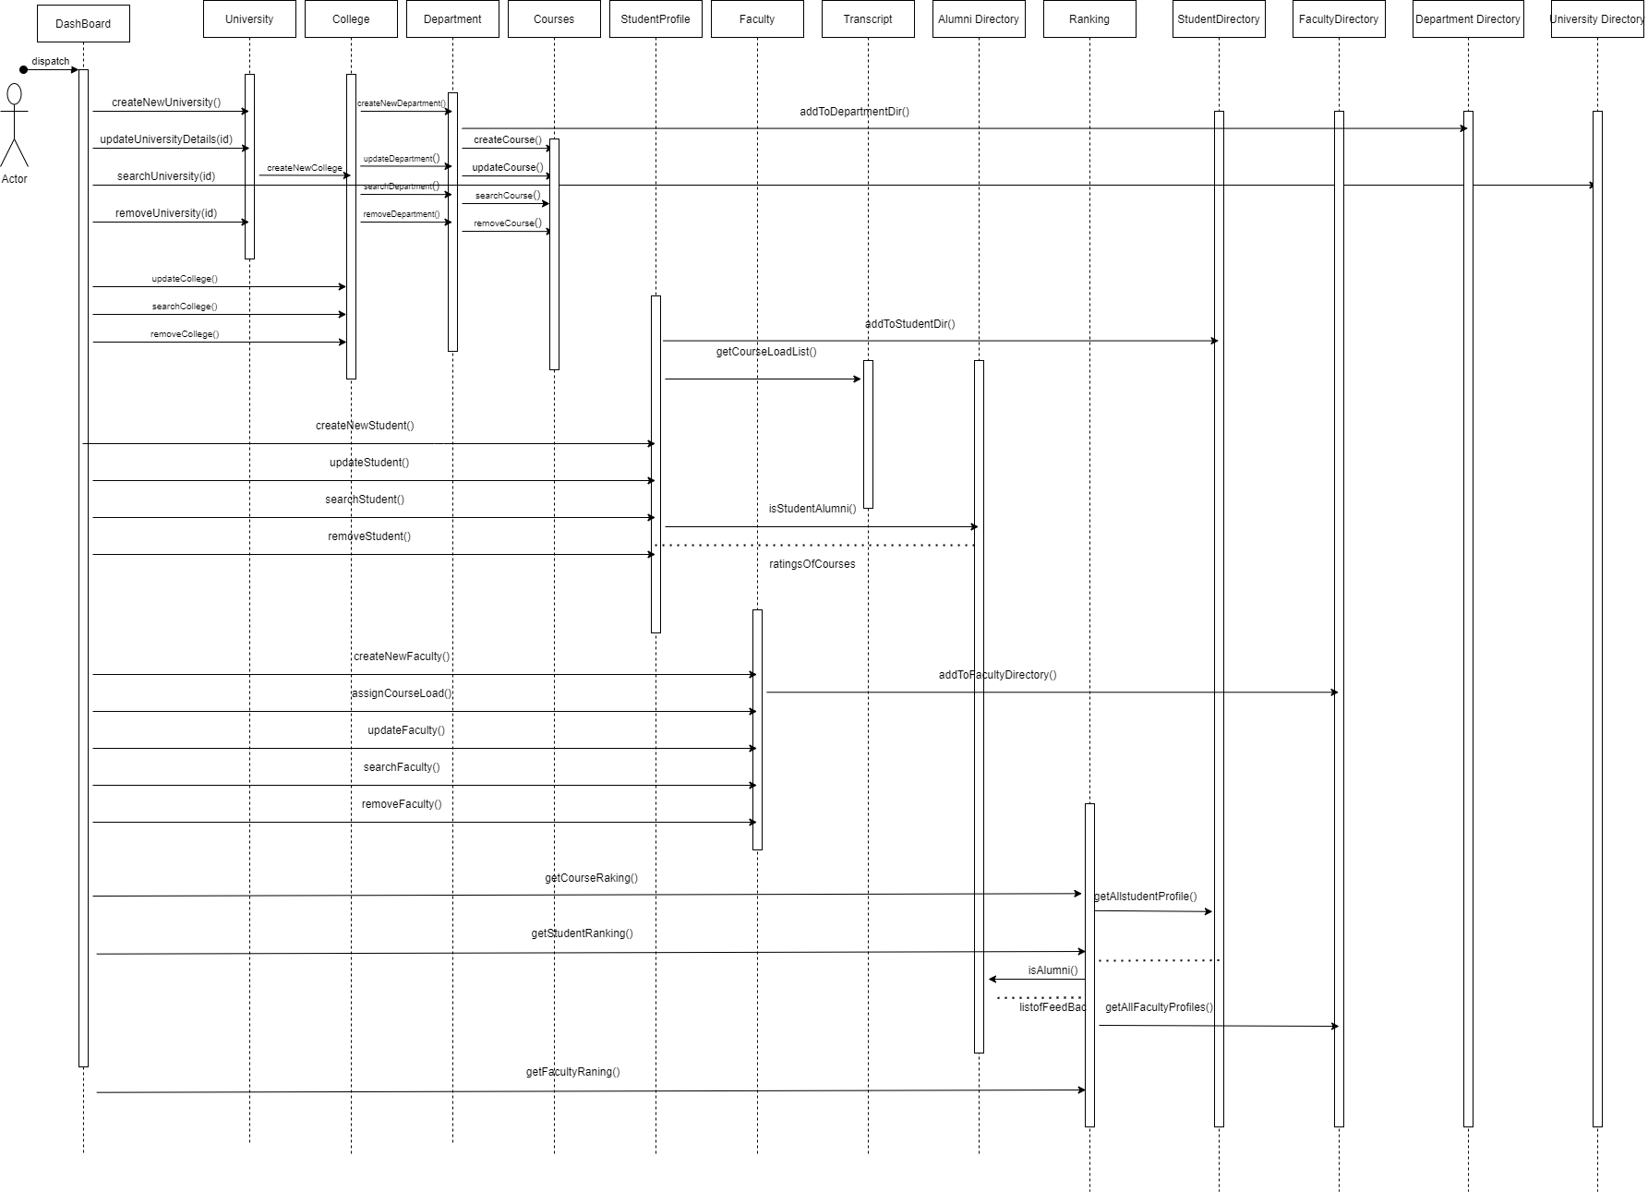
S e q u e n c e D I a g r a m

Slide 10
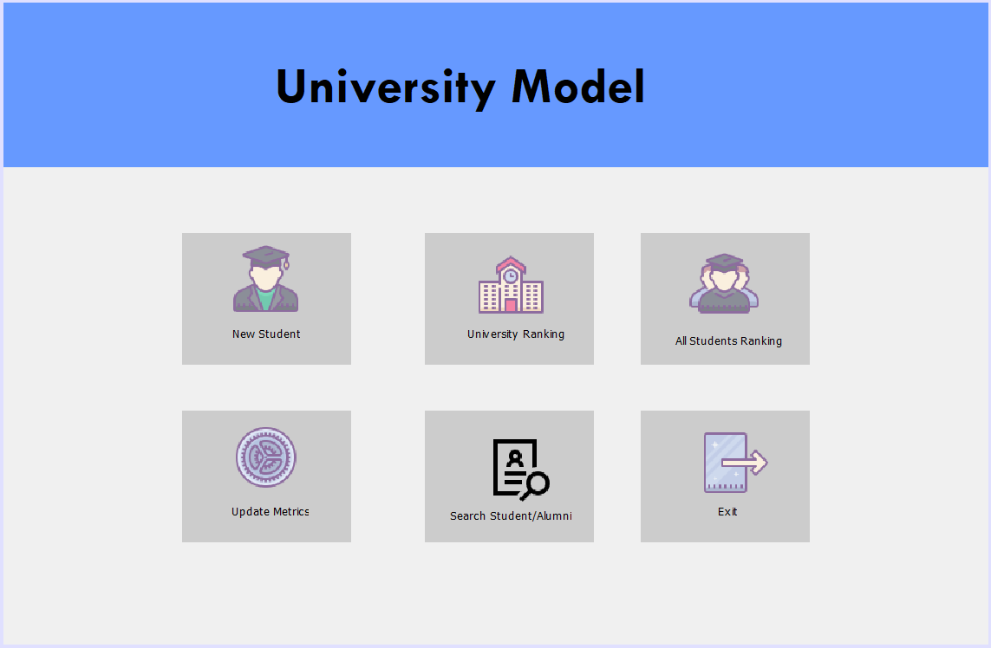
Dashboards

Slide 11
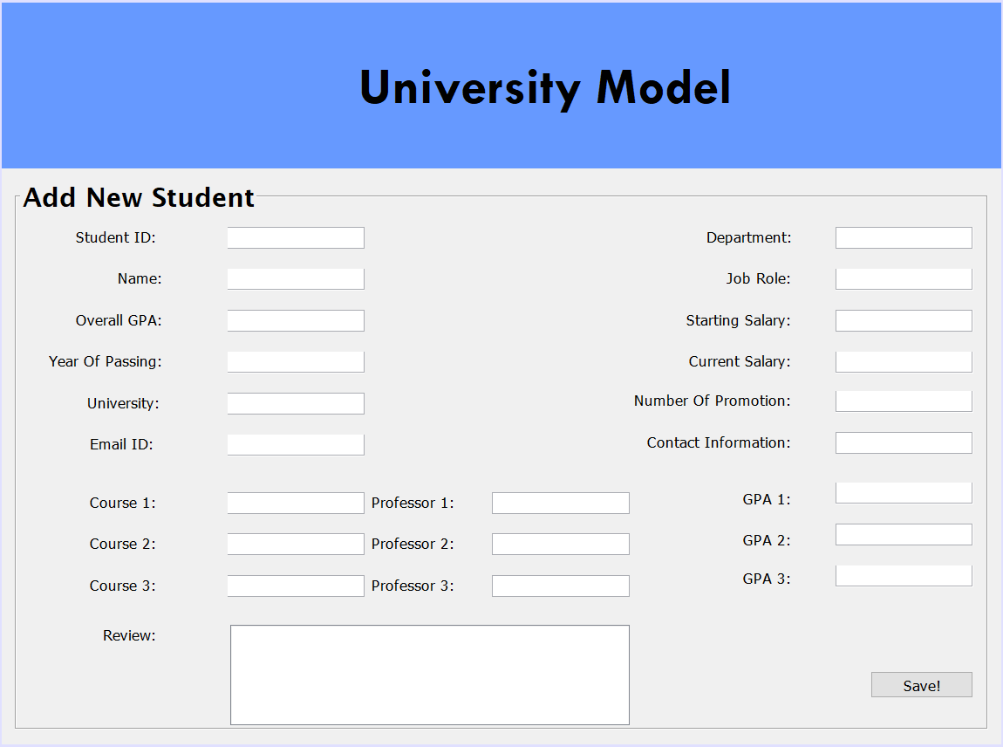

Slide 12
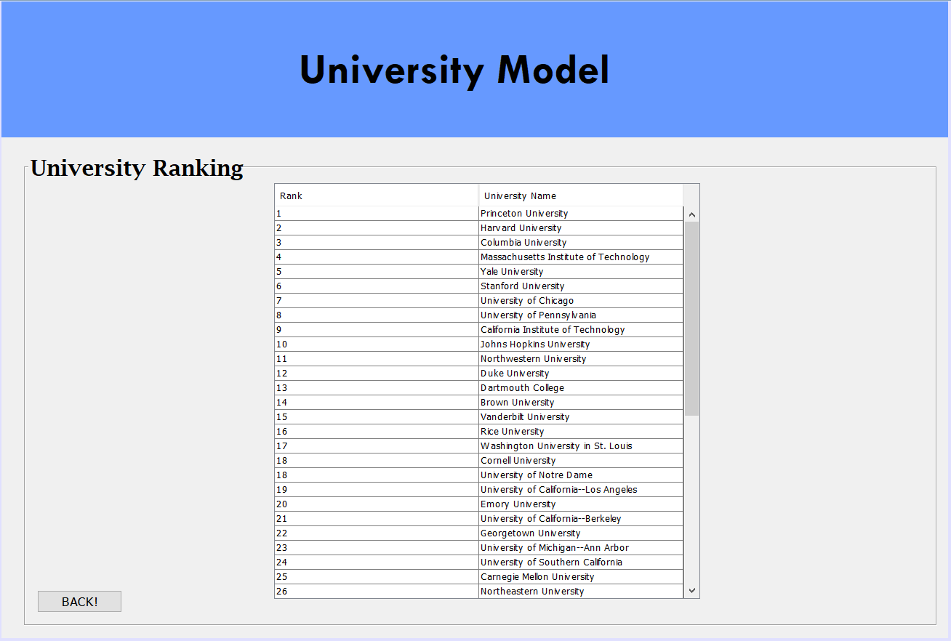

Slide 13
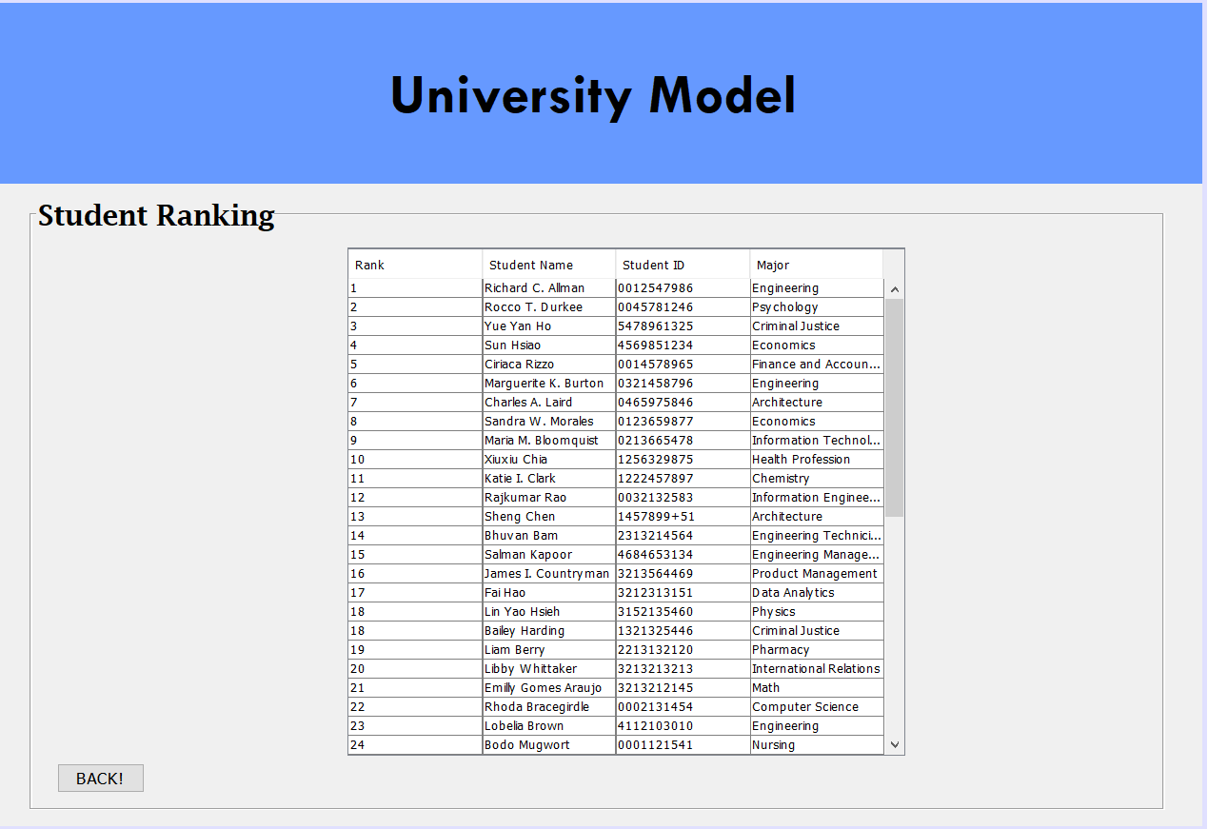

Slide 14
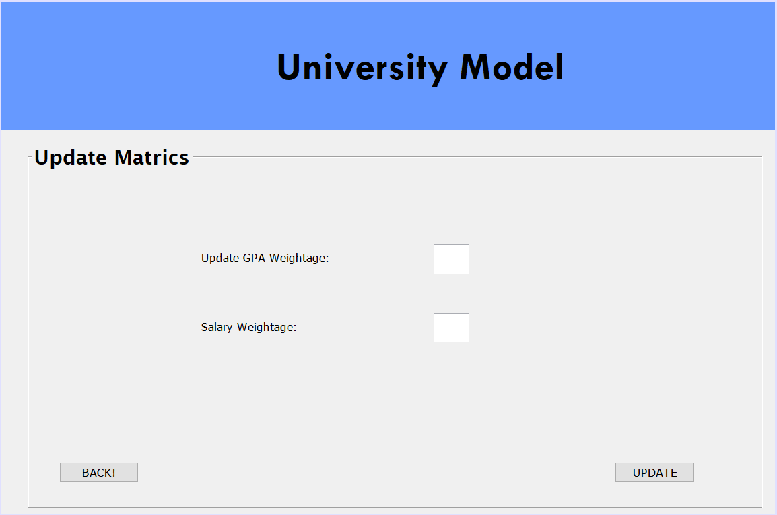

Slide 15
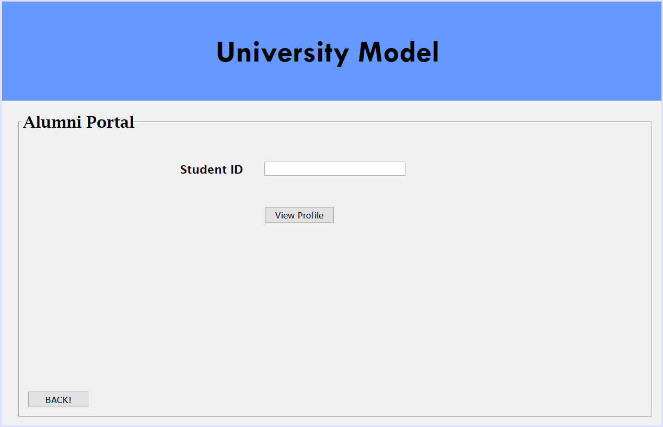

Slide 16
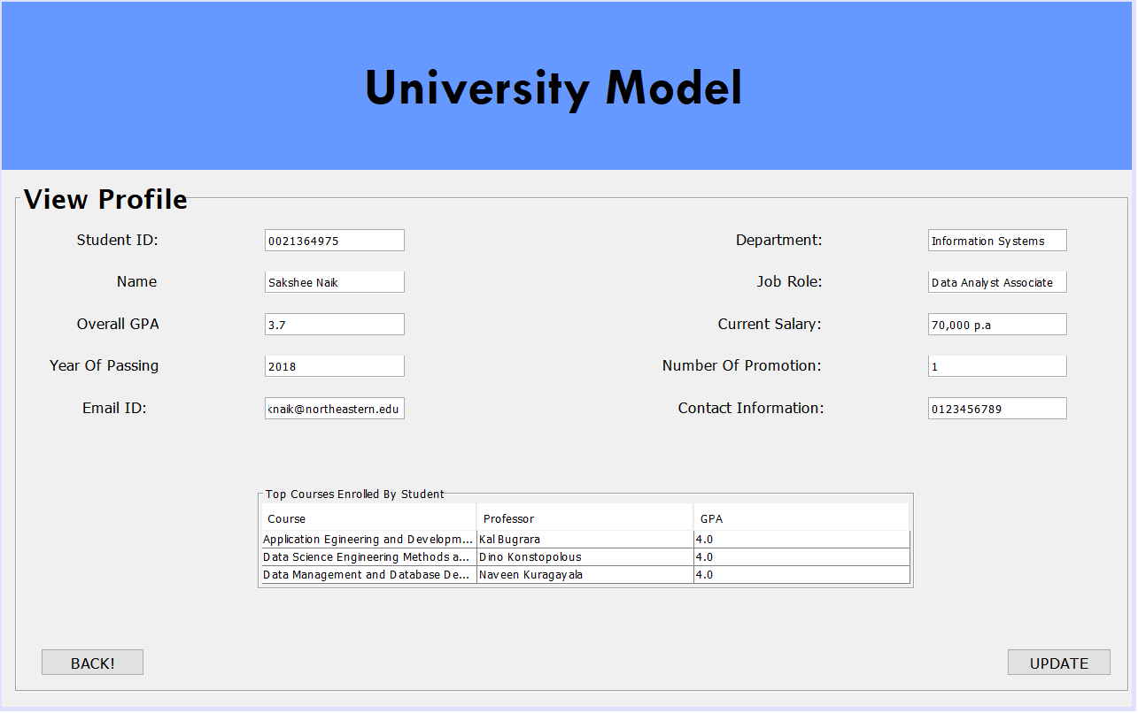

Slide 17
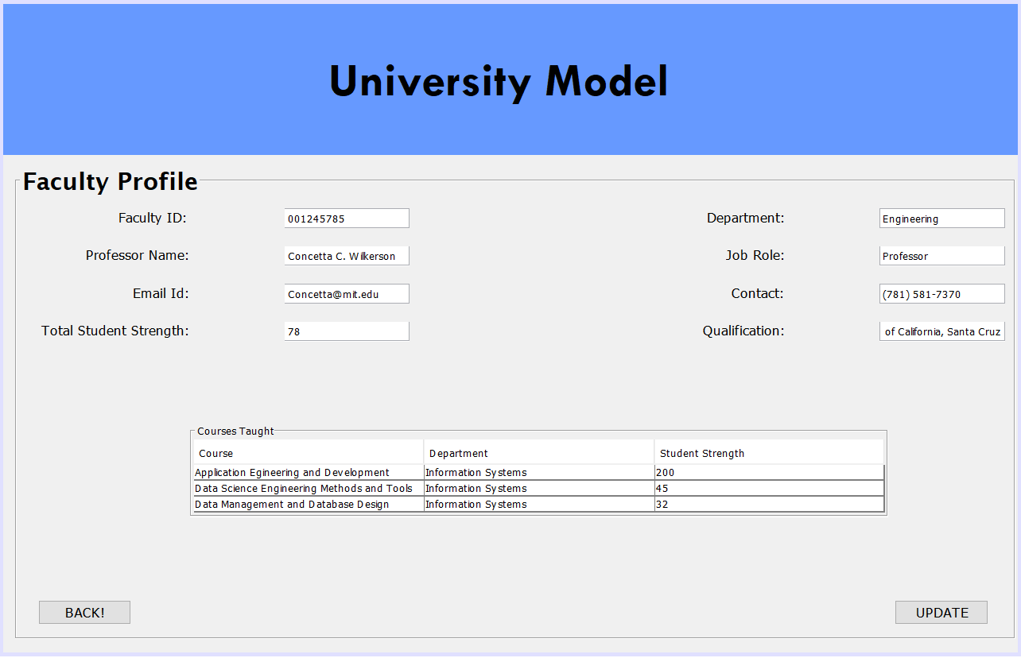

Slide 18
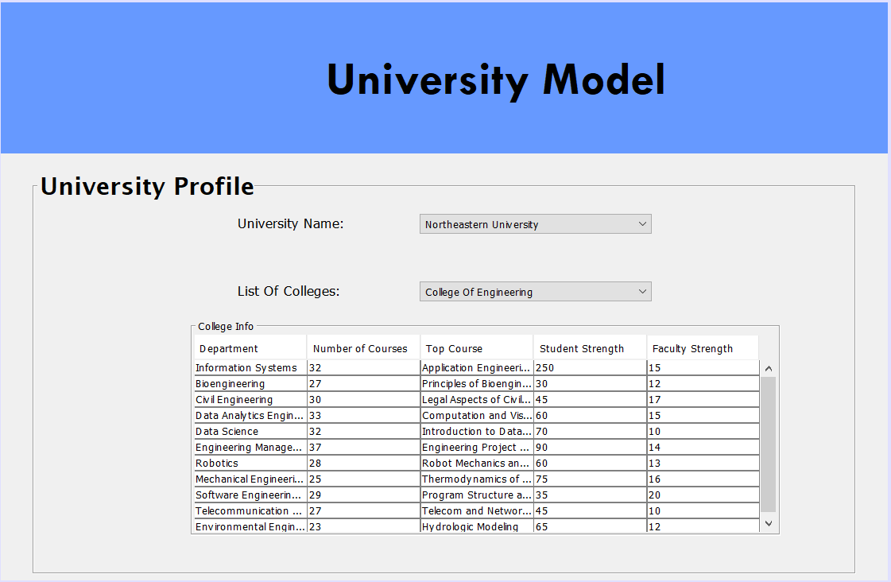


Slide 19
Thank You!

